Slide 1
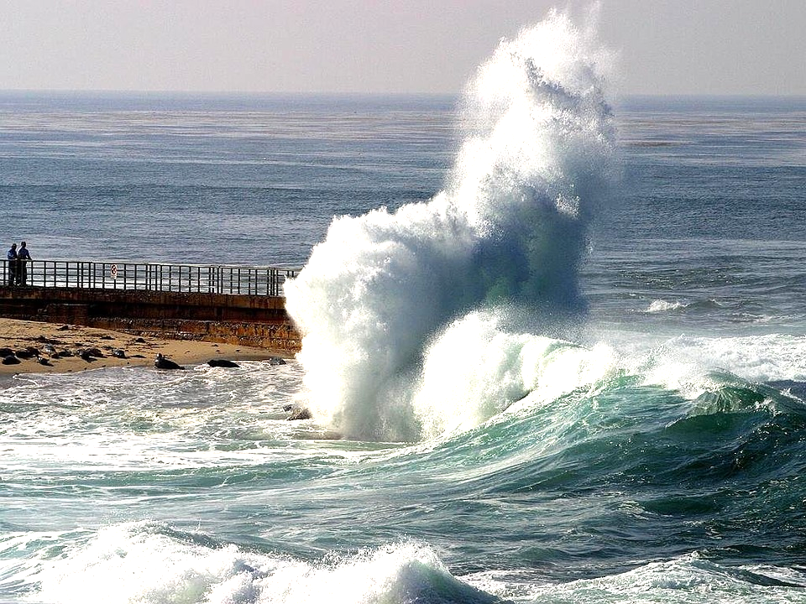
RHET 106N (08)
Week 13, Day 1
November 13, 2017

Slide 2
Agenda
United Nations Climate Change Talks are happening now.
Essay #2 Final Draft - Checklist and Expectations
Academic Summary & Response
Video - Bottled Water
Practice Summarizing

Slide 3
Academic Summary & Response
What do you put in an academic summary?
The main points of a source text in brief form—in your own words.
The ideas presented are the author’s and not your own.
You can combine several important points into a brief statement, or include minor points, depending on the purpose of your summary.
A good rule of thumb: a summary is never more than about one-quarter the length of the original; in most cases it is much shorter.
(But wait, there’s more…)

Slide 4
Academic Summary & Response
What does a good summary look like?
It begins with a broad overview (one or two sentences), which is then developed in more detail.
It uses quotation marks and page references whenever a phrase, a part of a sentence, or a complete sentence is taken directly from the source text.
It is brief, but thorough enough to accomplish its purposes.
It is an accurate reflection of the author’s viewpoint throughout.

Slide 5
Academic Summary & Response
What goes in the response?
This is where your analysis and response comes in. You present your point of view with evidence to support it.
Do you think the author succeeded at achieving his or her purpose with the intended audience? Why or why not? Provide evidence to support your answer.

Slide 6
Academic Summary & Response
What goes in the response?
Think about your own knowledge and experience in relation to the text.
What in the author’s text resonates with your own experience?
What in the author’s text does not conform to your experience or point of view?
What in the author’s text is clearly at odds with your experience or point of view?

Slide 7
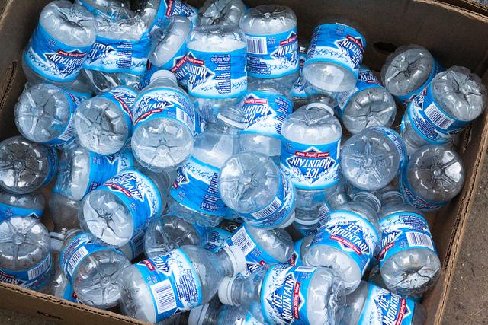
Video
The Story of Bottled Water
http://storyofstuff.org/movies/story-of-bottled-water/

